Slide 1


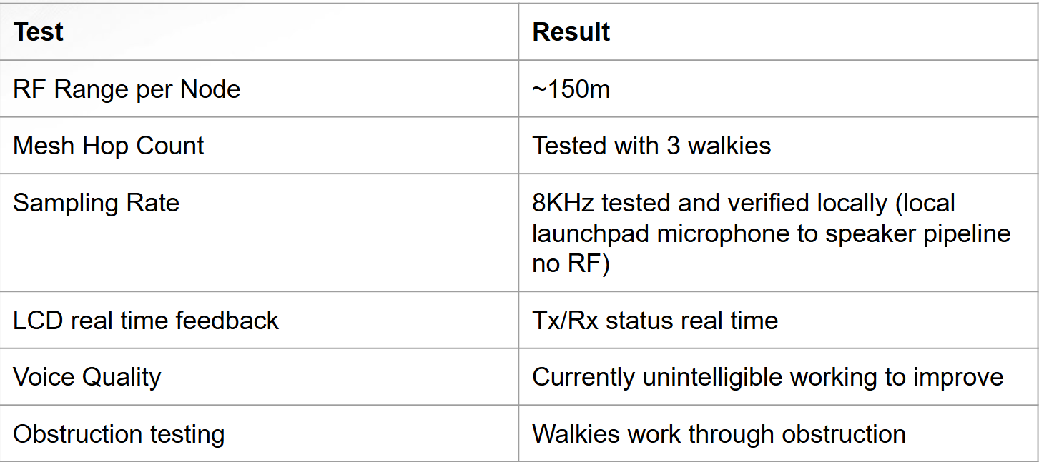
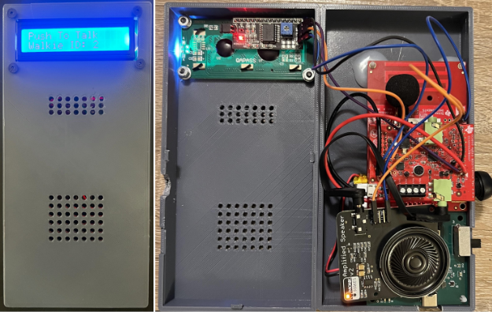
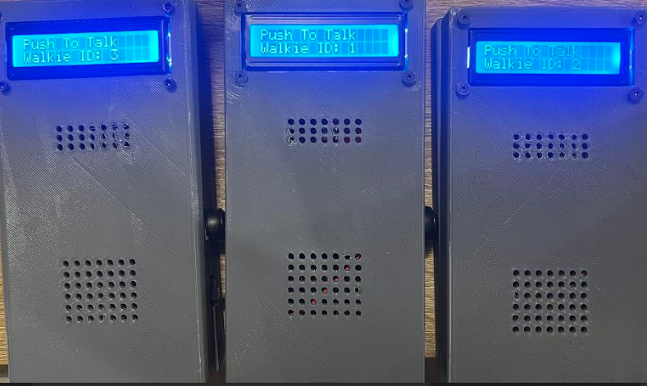
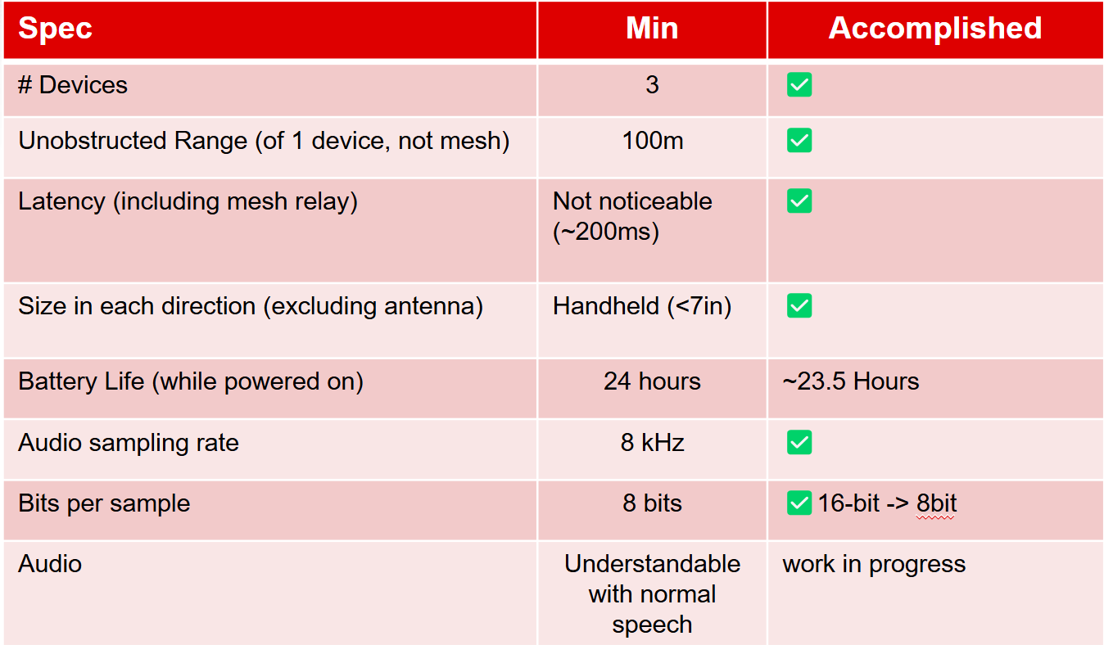
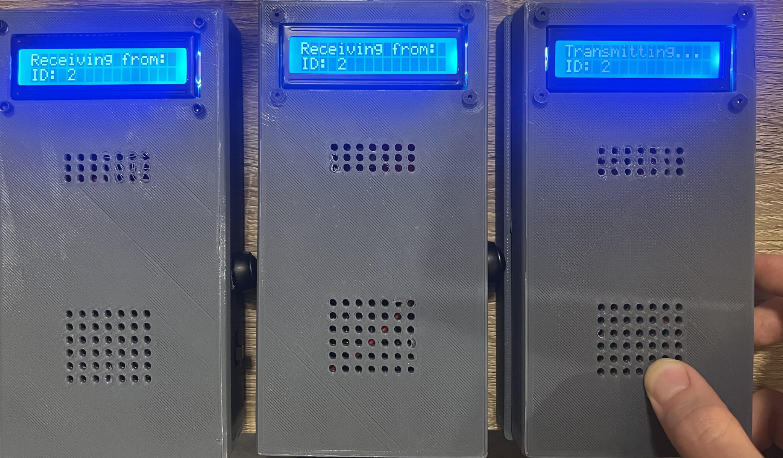
Booth Number: 340
Mesh Walkie Talkies
Cole Cieslewicz, Jaiah Steele, Junsu Yeo
Sponsor: Guiseppe Rizzi
Problem Definition
Traditional walkie-talkies, while reliable, are limited by their direct line-of-sight range and lack in networking capabilities. Our solution enhances this functionality by integrating mesh networking technology, enabling each device to function as both a receiver and transmitter, significantly extending the communication range and network reliability.
Engineering Analysis
Below are the primary steps used in configuring the devices to behave appropriately:
Switched from Wi-SUN to TI Proprietary Mesh for lower latency.
Enabled bidirectional RF communication with PTT and UART support.
Used GPIO interrupts for push-to-talk; LCD updates status in real-time.
Compressed 16-bit I2S audio to 8-bit PCM at 8kHz using various codecs.
Implemented echo-based packet relaying with Walkie-ID for pseudo full-duplex.
Transmits 255-byte packets every 41ms using 50kbps Sub-1 GHz PHY.
Table 2. Walkie Validation
Table 3. Power Consumption
 | Input Voltage | Current Draw
Microphone | 5.0V | 17mA
Speaker | 5.0V | 317mA
LCD Display | 5.0V | 25mA
Microcontroller | 3.3V | 16mA
The four components within our walkie-talkie that draws current from the battery is listed in Table 1 above. The bulk of our current draw comes from powering the large speaker taking 317mA. However, with out 3.7V 2500mAh LiPo battery, it is able to power the device for 23.5 hours assuming 20% receiving, 20% transmitting, and 60% idle. The battery fully charges in 5-6 hours with a charging current of 1250mA.
Methodology
The project is divided into three subsystems: power, mesh networking, and the audio/user interface system.
Power System
Designed a low dropout regulator (LDO) to drop 3.7V to 3.3V.
Designed a boost converter to step up 3.7V to 6.0V fed into a LDO to drop to 5.0V.
Designed a battery charger & battery protection circuit to charge at 1250mA and protect the battery at 3.0-4.2V.
Mesh Networking
Using base programs in Code Composer Studio software, the mesh network was created to enable small packets of data to be transmitted to and from devices.
Utilized TI’s proprietary communication protocol operating at 915 MHz for high quality data transfer.
Audio/User Interface
Utilized the TLV320AIC3254 audio codec for high-quality mono audio sampling via I2S at 8 kHz.
Implemented 16-bit to 8-bit audio compression using ADPCM for efficient RF transmission.
Integrated real-time I2S audio input (microphone) and output (speaker), with audio routed through an I2C-controlled codec.
Implemented a push-to-talk (PTT) system using GPIO interrupts—when the button is pressed, audio capture and transmission begin; when released, the device returns to receive mode.
Outcomes
Our walkie-talkies were able to communicate via mesh network by functioning as both a receiver and a transmitter. The LCD is able to update dynamically, indicating the origin of the audio on each device. Due to our audio PCB teammate dropping the course, there were problems with audio compression leading to inaudible speech on the receiver. The battery and power system was able to power the device, under normal usage conditions, for 23.5 hours.
Impact
The devices enable long-range communication because of the network advantage achieved via mesh hopping. This is applicable in a wide variety of areas:
Search and Rescue: People spreading out over a specific area where everyone needs to hear everyone else.
Group Outdoor Activity: Handheld, with a long battery life, and easily-operated, these devices help keep families and friends in contact with everyone.
Environments with Obstructions: Line of sight connection is not required (it can bounce around the obstruction)
Figure 1. Exterior/Interior Design of the Walkie Talkie
Table 1. Sponsor Specs
References
Texas Instruments, TPS796 Low-Dropout Regulator datasheet, Rev. Y, Apr. 2016. [Online].
Microchip Technology Inc., MIC2288 1.2MHz PWM Boost Converter datasheet, DS20006034C, May 2018. [Online].
STMicroelectronics, "LDL1117: 1.2 A high PSRR low-dropout linear voltage regulator," Datasheet, Rev. 7, Jan. 2021. [Online].
Texas Instruments, "BQ297xx: Cost-Effective Voltage and Current Protection Integrated Circuit for Single-Cell Li-Ion and Li-Polymer Batteries," Datasheet, Rev. I, Aug. 2024. [Online].
Texas Instruments, BQ24072 Li-Ion Linear Charger and Power-Path Management IC datasheet, Rev. I, Jul. 2015. [Online].
Texas Instruments, CC1354P10 SimpleLink™ datasheet, Rev. B, Dec. 2023. [Online]
Acknowledgements
Giuseppe Rizzi, Dr. John Lusher
Figure 4. LCD Updates

